Slide 1
Street Photography with Valérie Jardin
Paris and London
September and October, 2015
Judy Robb’s photos

Slide 2
According to Valérie Jardin…
“There are stories happening all around us and it is our responsibility to see them and record them in the best possible way”
“Seeing the extraordinary in the ordinary is what street photography is all about”
“Immortalizing beautiful moments that will never happen again”

Slide 3
Attributes of a Strong Street Photo
1. Story
2. Expression or Body Language
3. Human Form in the Urban Landscape
4. Exceptional Light
5. Beautiful Moments
6. Extraordinary in the Ordinary

Slide 4
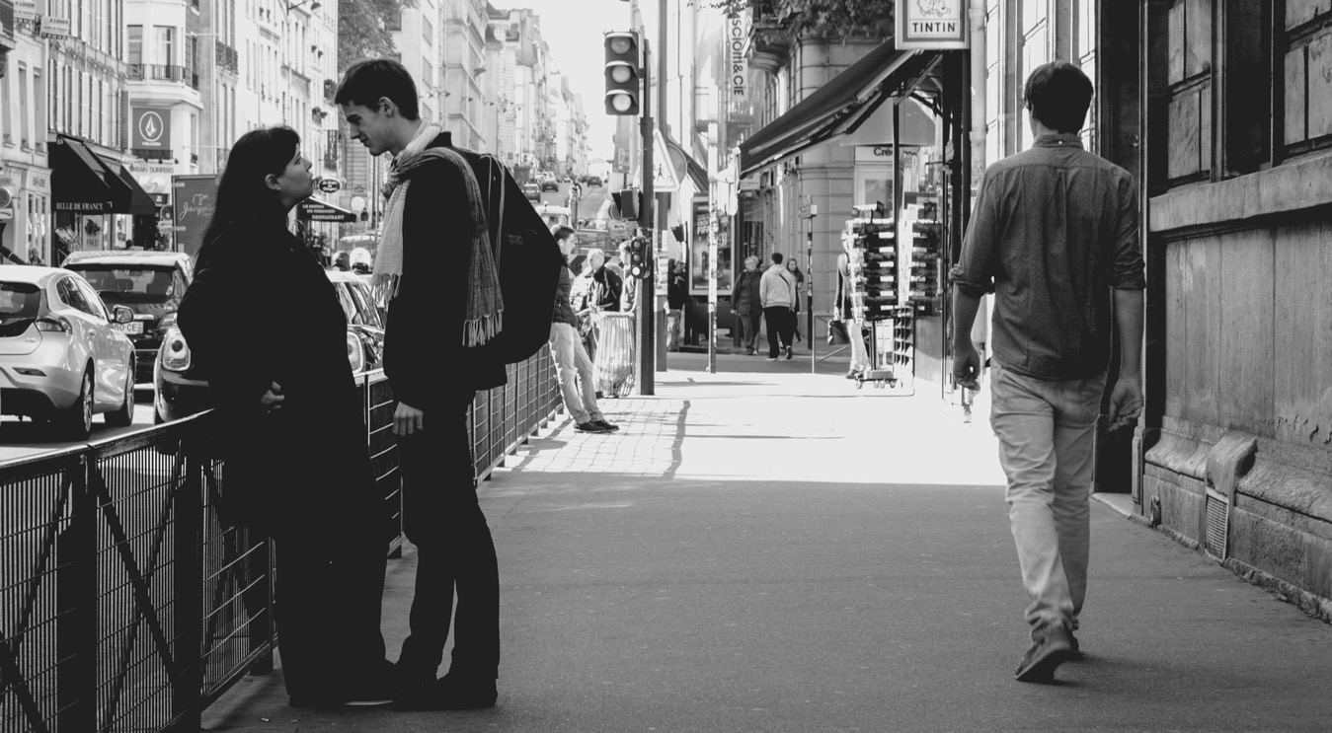
1. Telling a story…

Slide 5
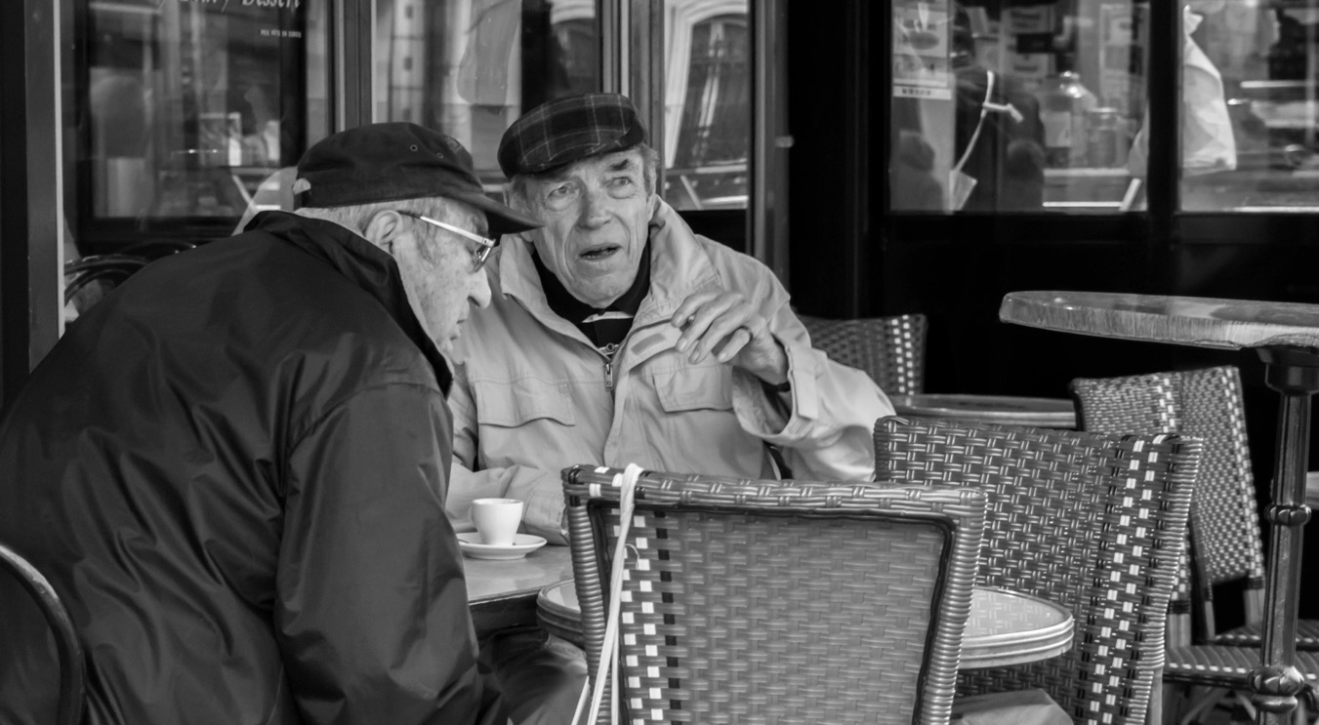
Stories…

Slide 6
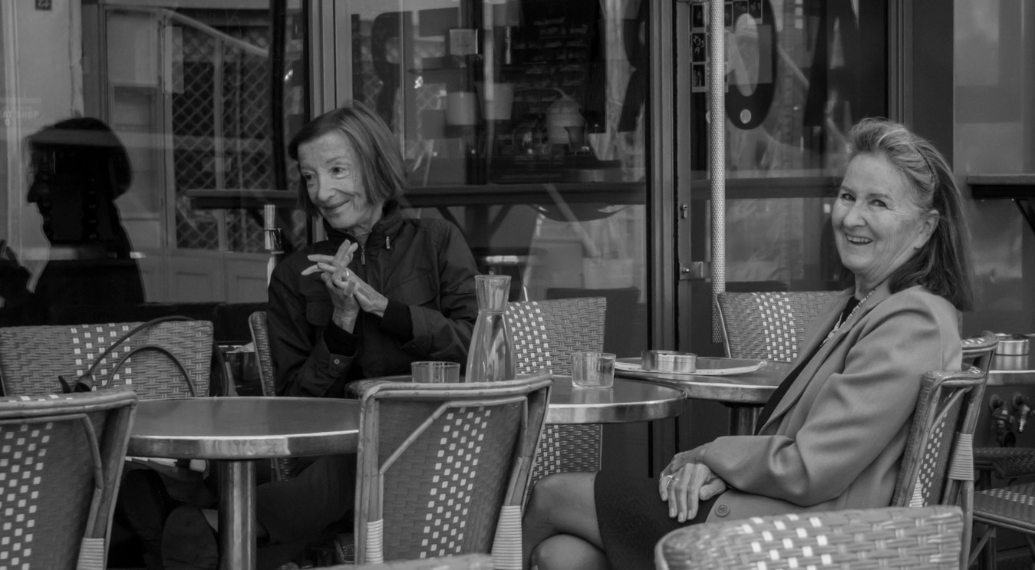
The Women of Paris

Slide 7
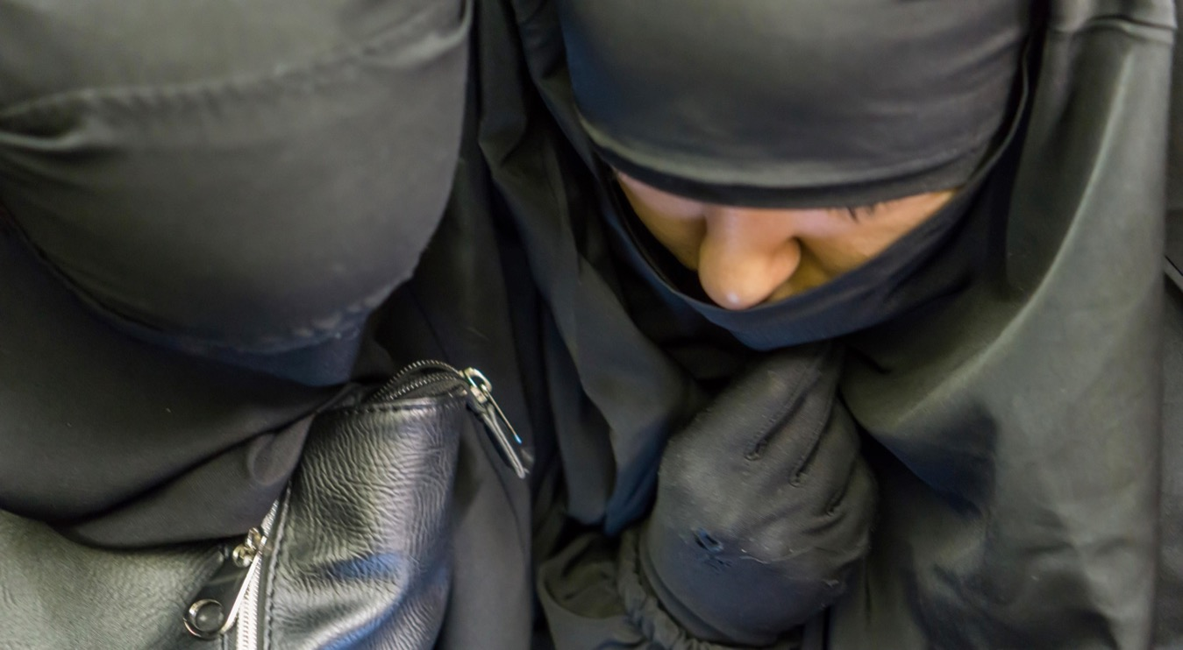
On the Metro

Slide 8
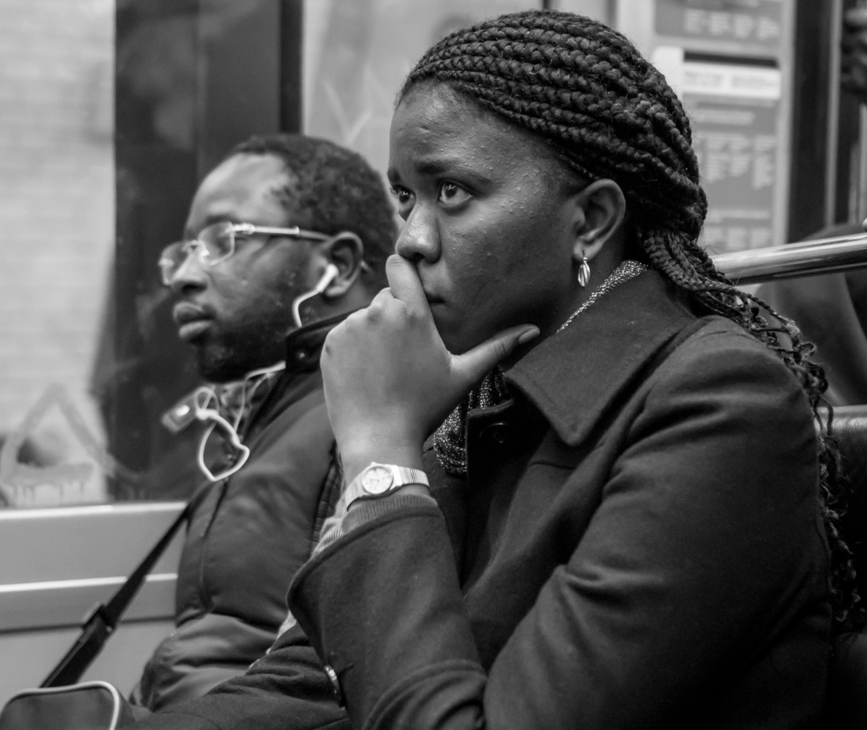
Lost in thought…

Slide 9
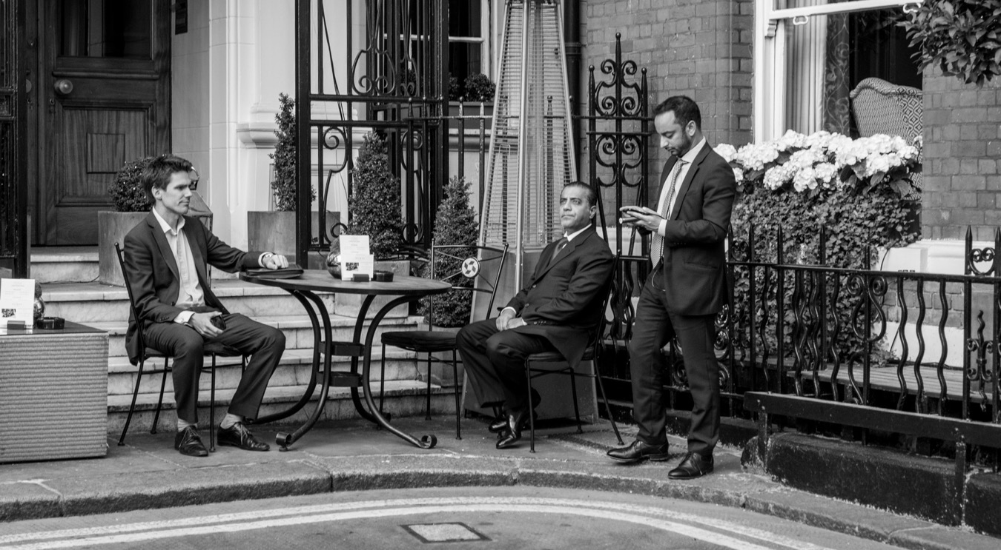
London

Slide 10
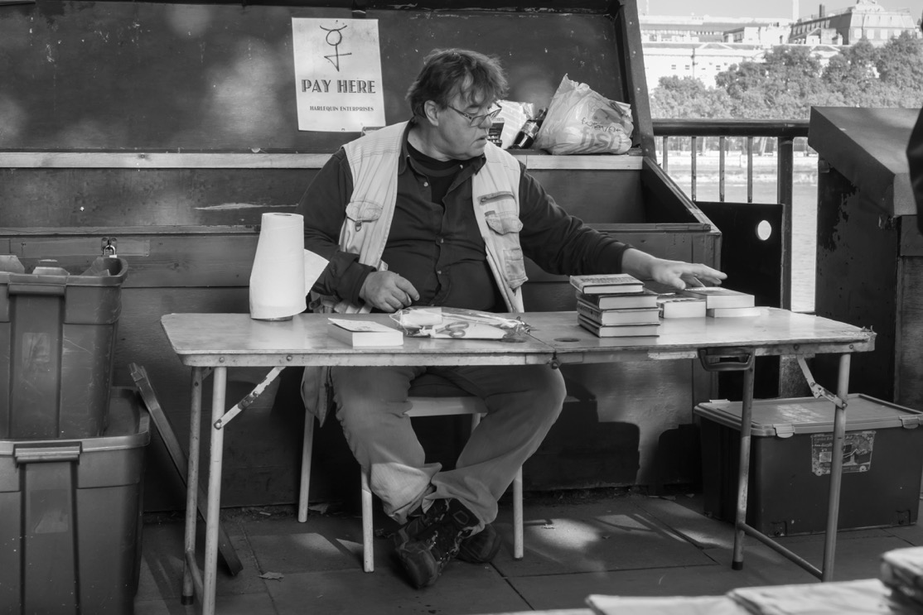
Pay Here

Slide 11
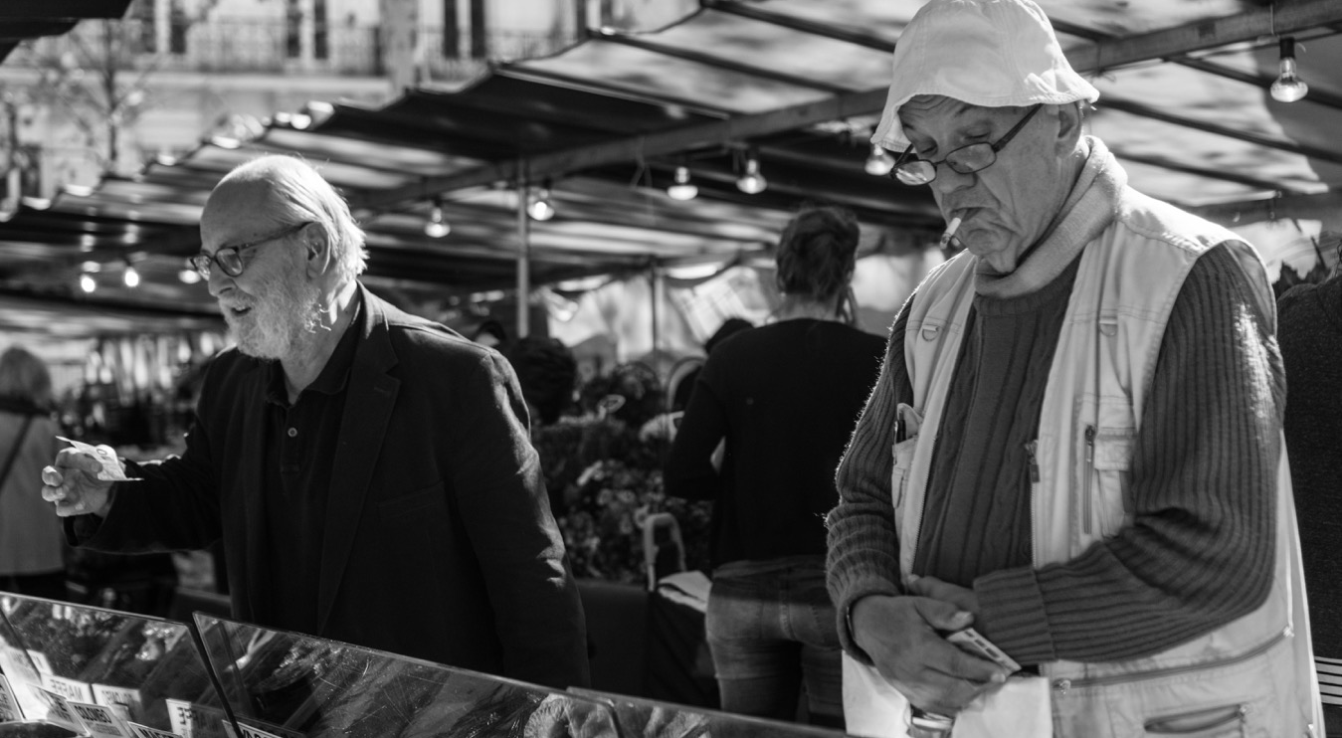
2. Expression or Body Language

Slide 12
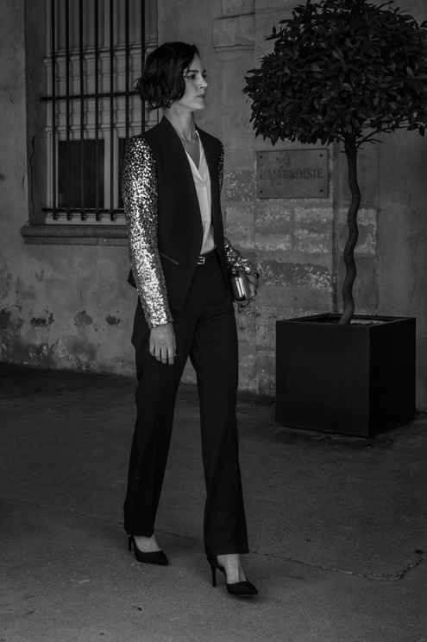
Paris Fashion Week

Slide 13
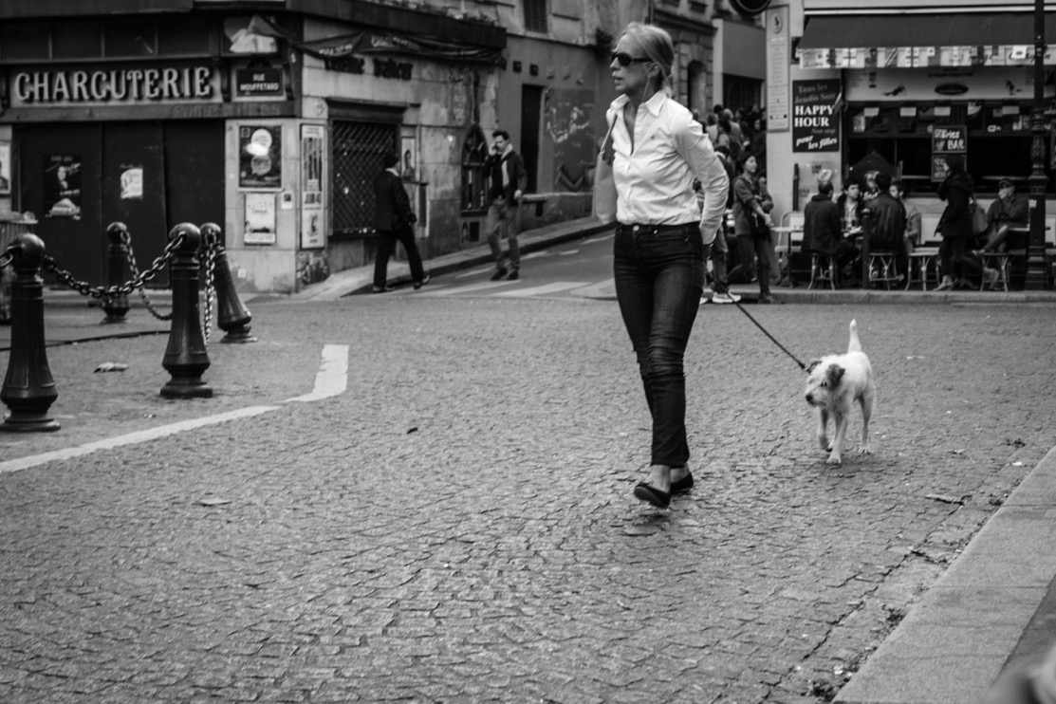
Typical Paris scene

Slide 14
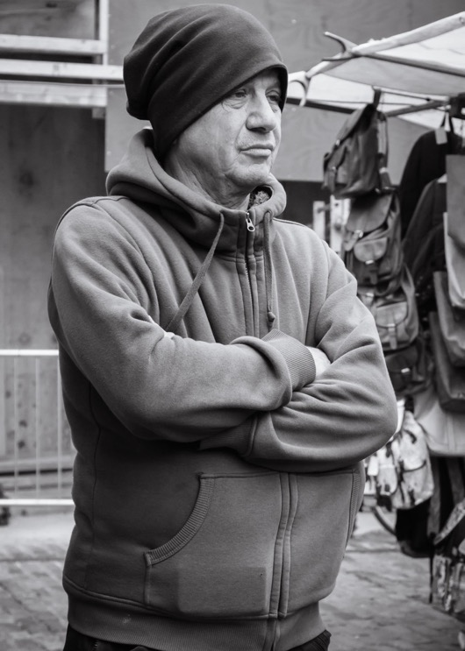
At the Market

Slide 15
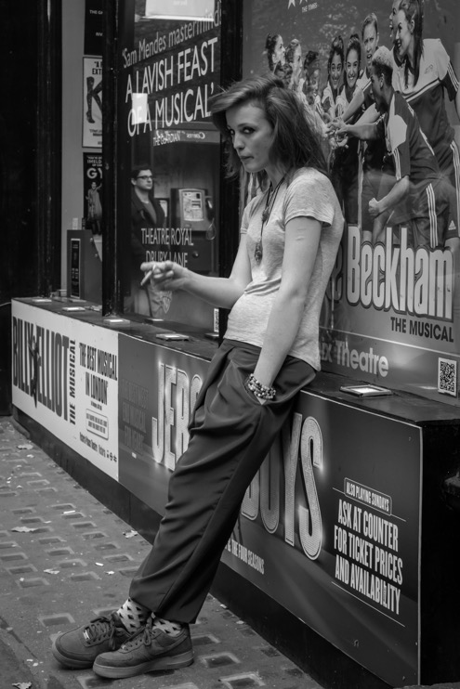
London Attitude

Slide 16
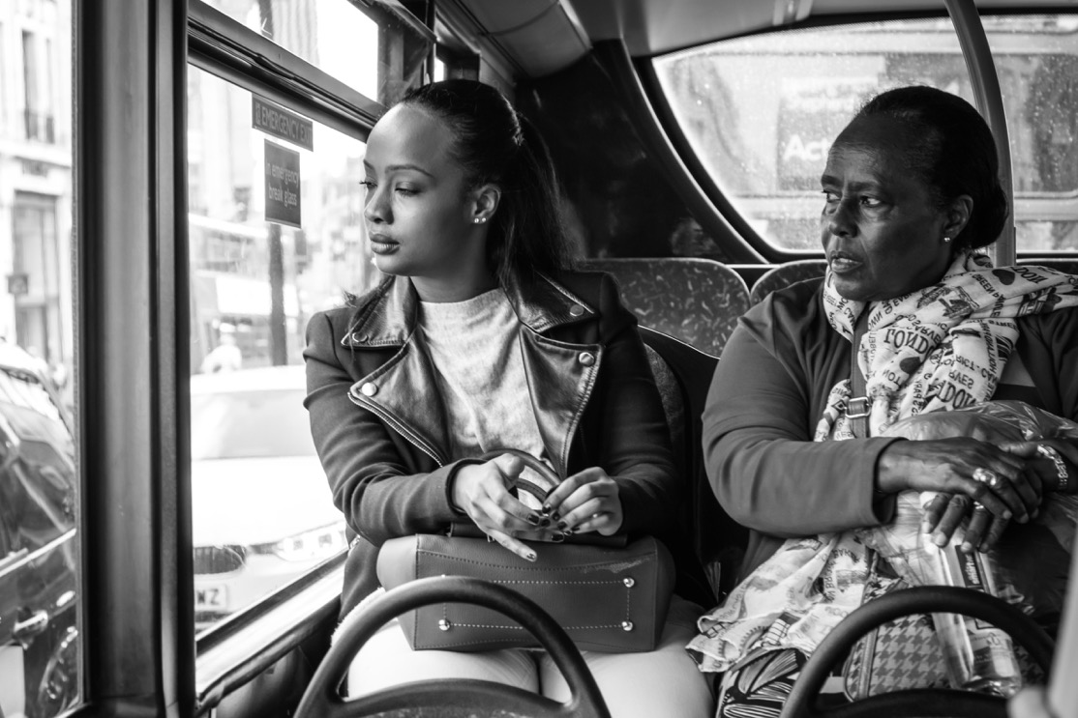
Expression

Slide 17
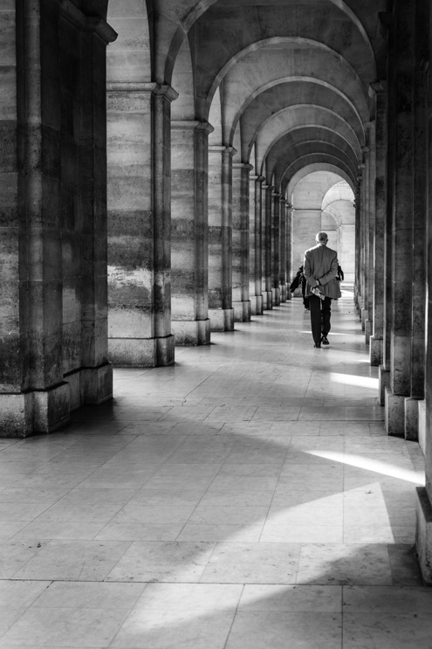
3. Human form in the urban landscape

Slide 18
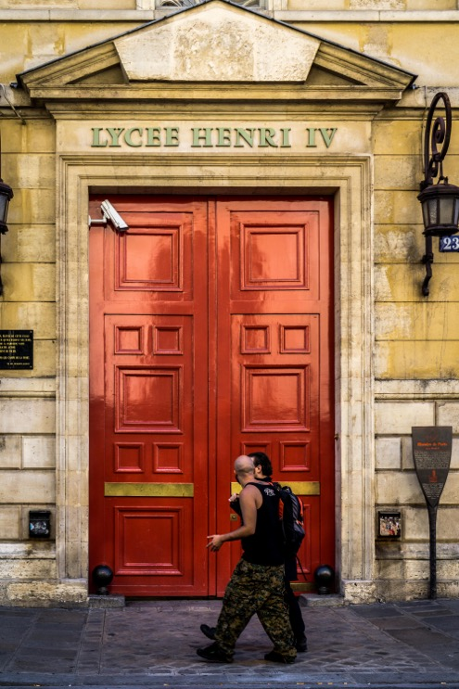
Humans as perspective

Slide 19
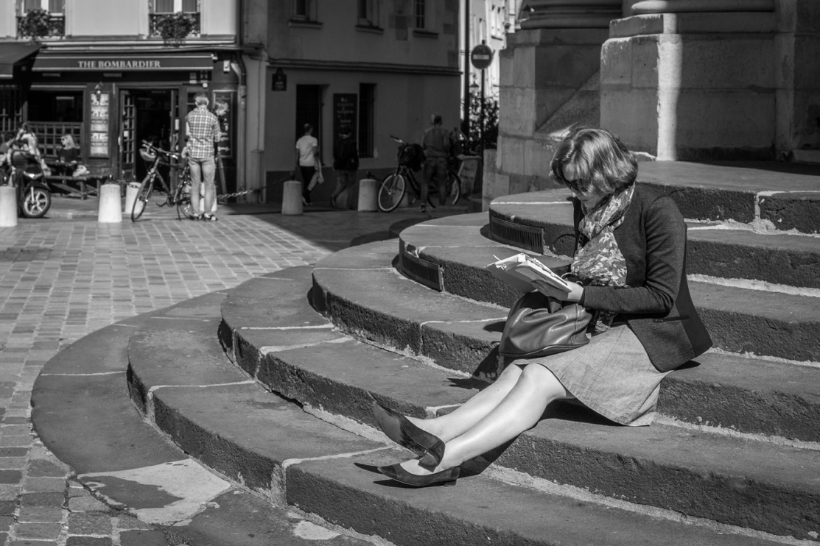
Repeating patterns

Slide 20
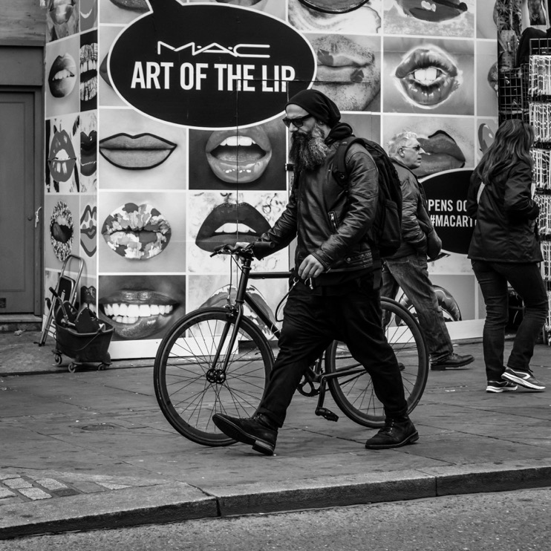
Landscape London

Slide 21
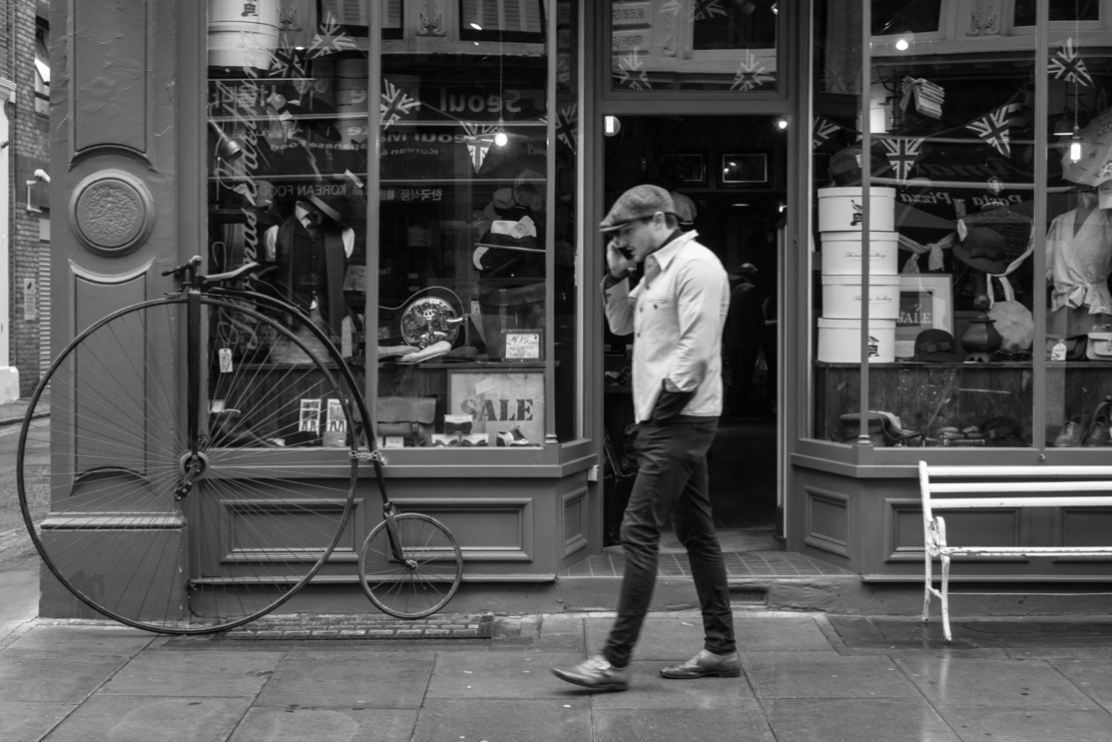
Covent Gardens

Slide 22
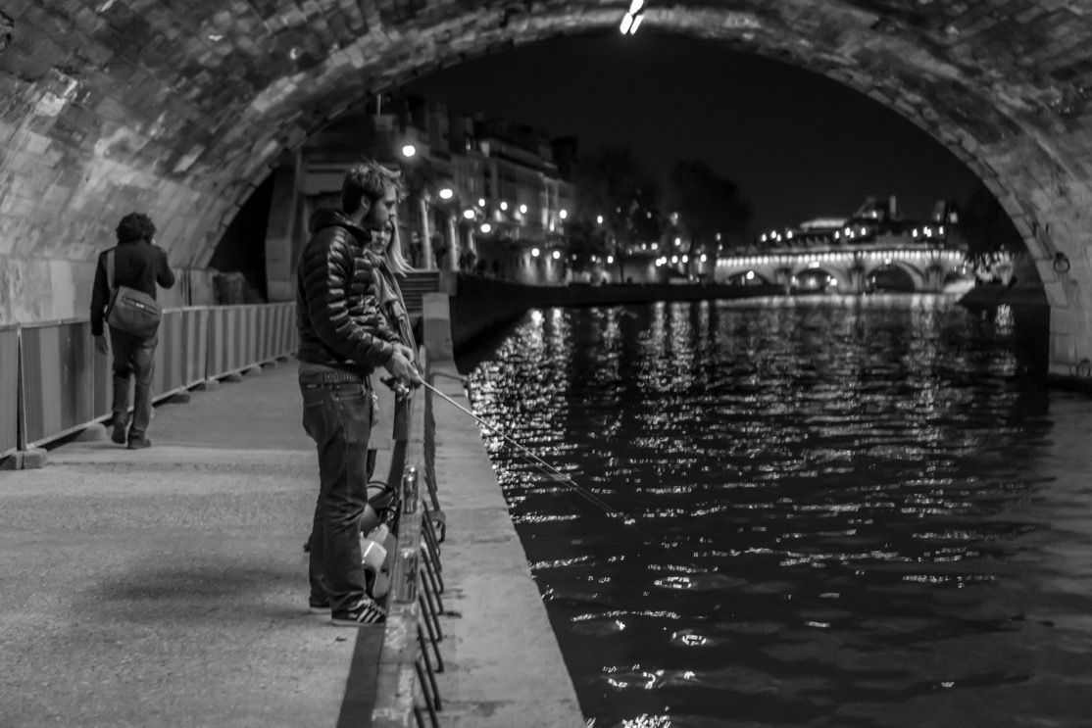
Fishing in the Seine

Slide 23
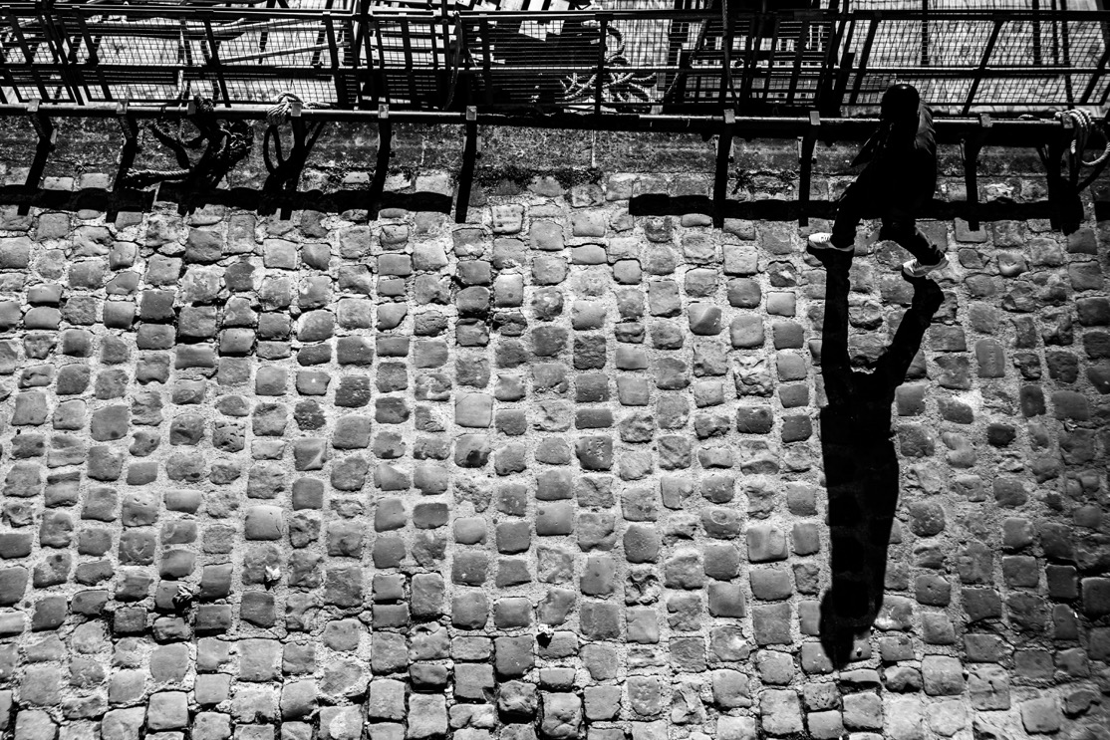
4. Exceptional Light

Slide 24
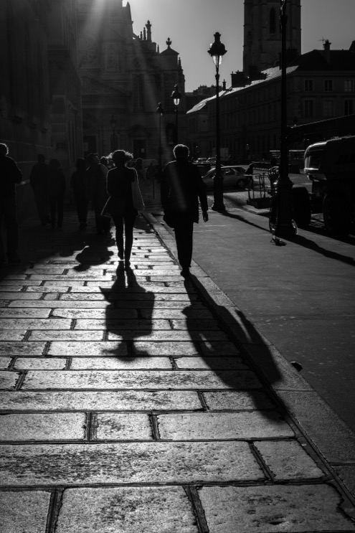
Morning on the bridge

Slide 25
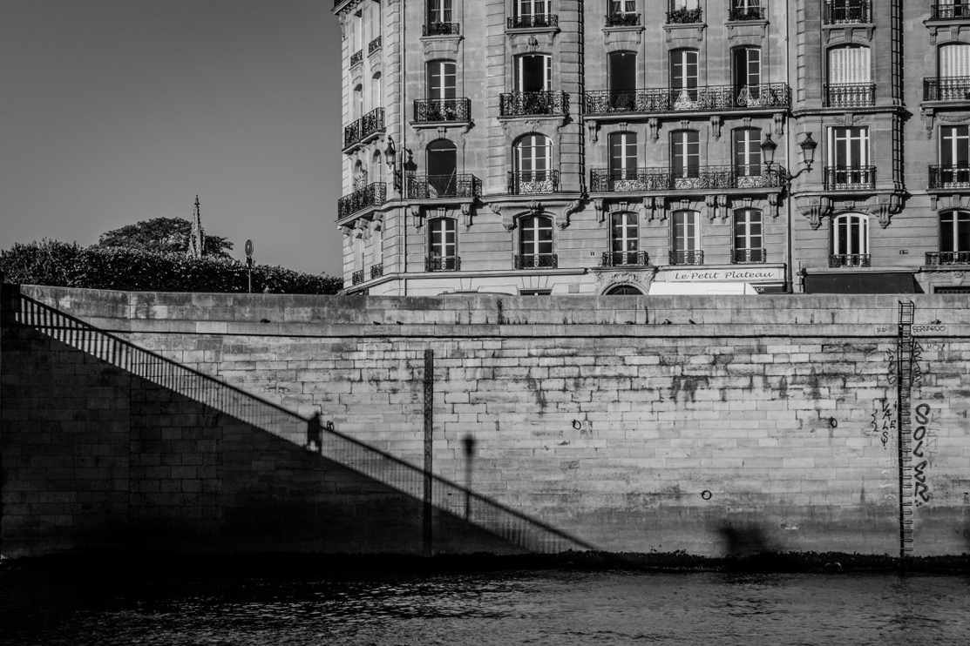
Silhouetted Bridge

Slide 26
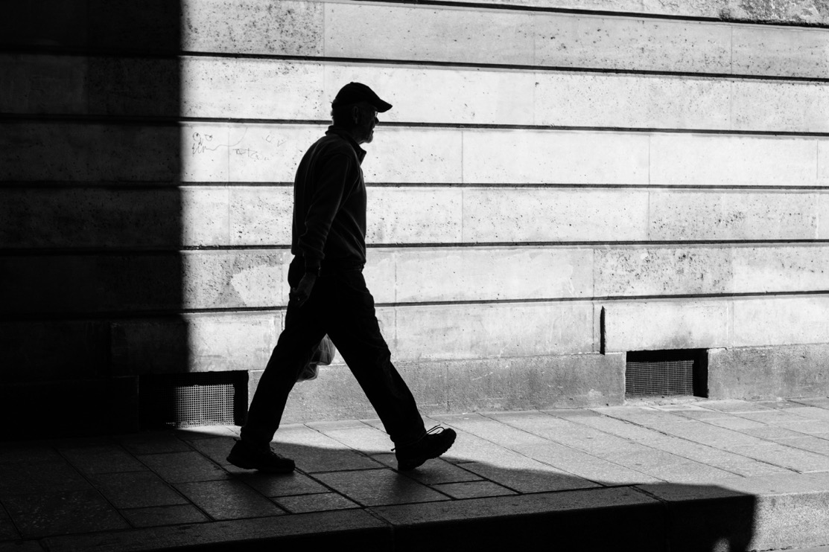
Sunny silhouette

Slide 27
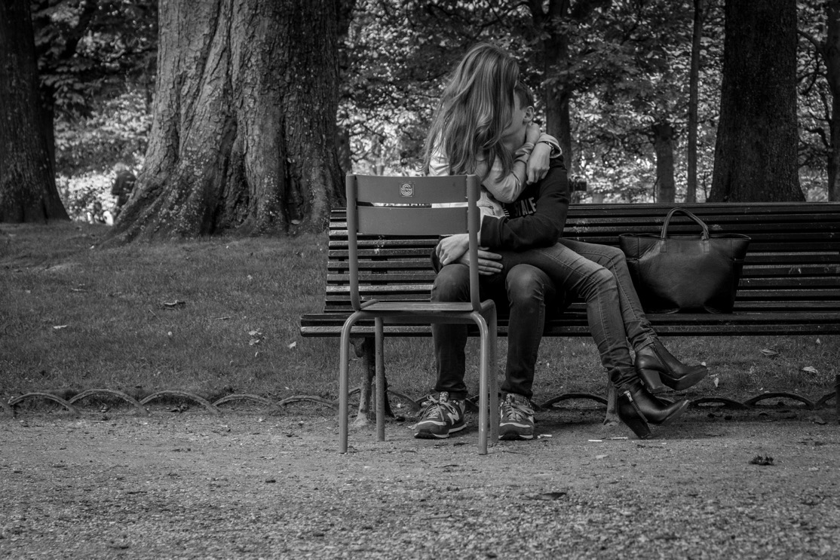
5. Beautiful moments

Slide 28
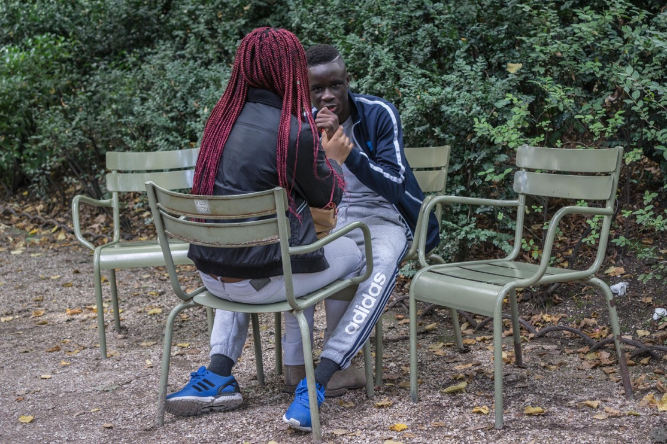
Love in colour

Slide 29
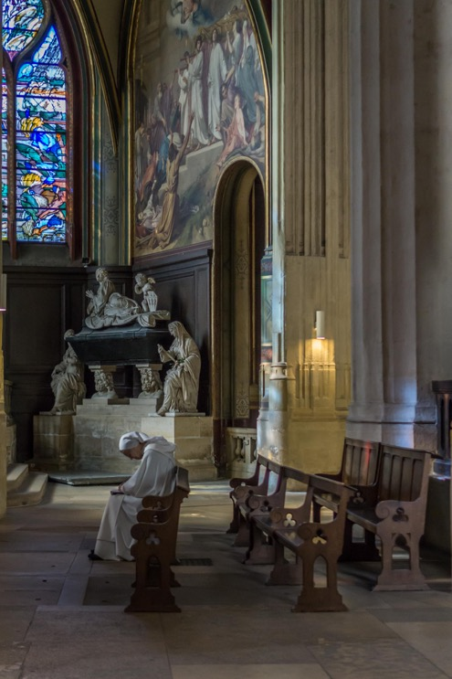
Serenity

Slide 30
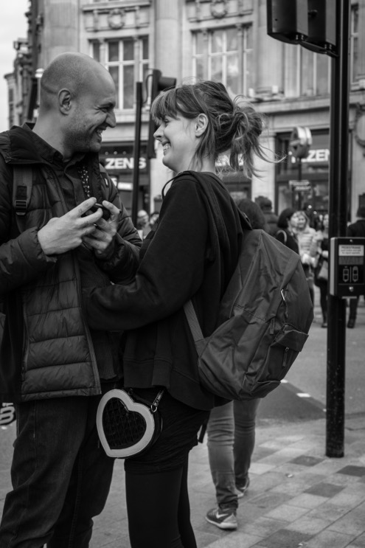
London Lovers

Slide 31
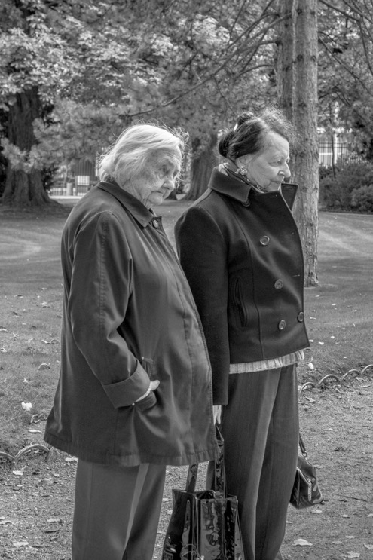
6. The extraordinary in the ordinary

Slide 32
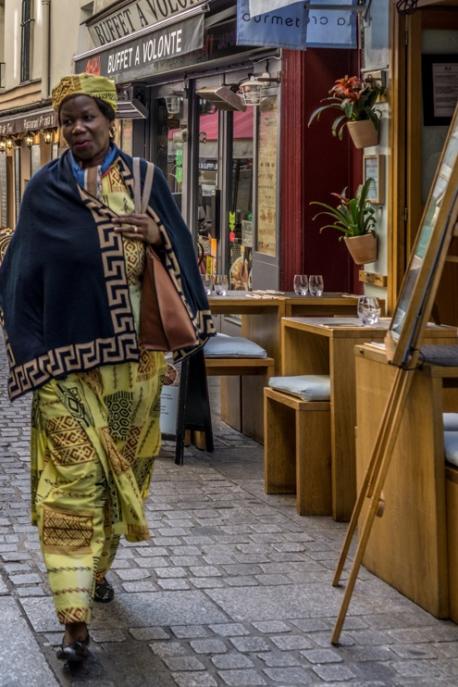
Market Day

Slide 33
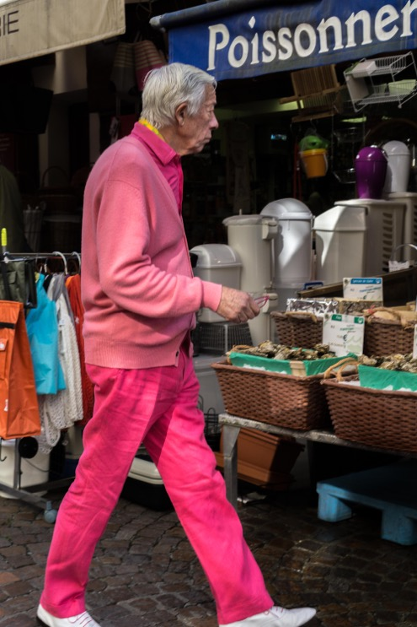
Market Day

Slide 34
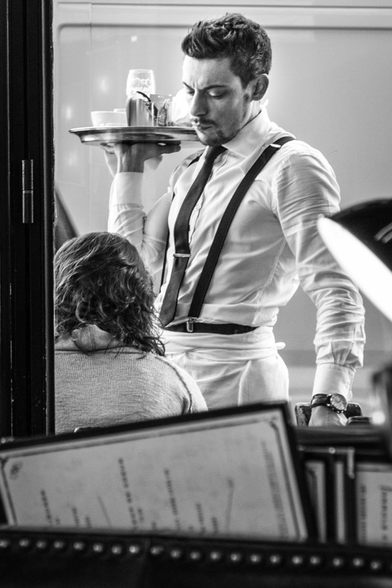
The waiter

Slide 35
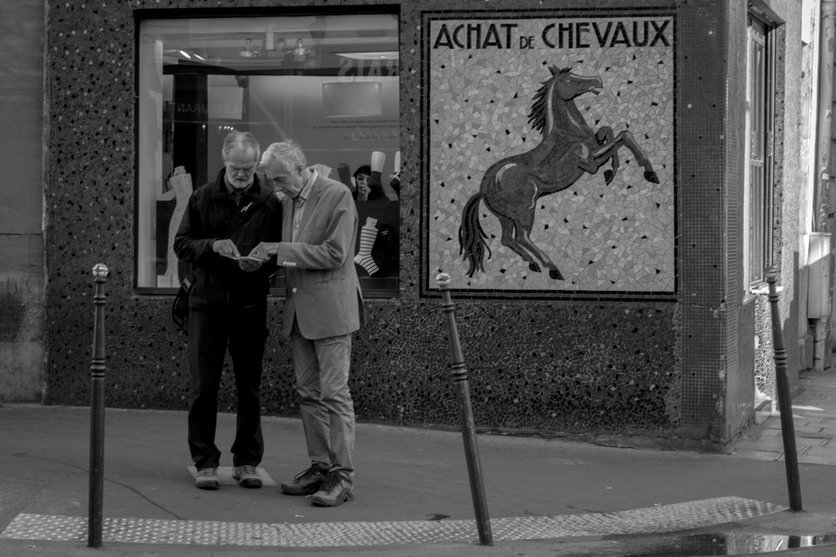
The Mosaic

Slide 36
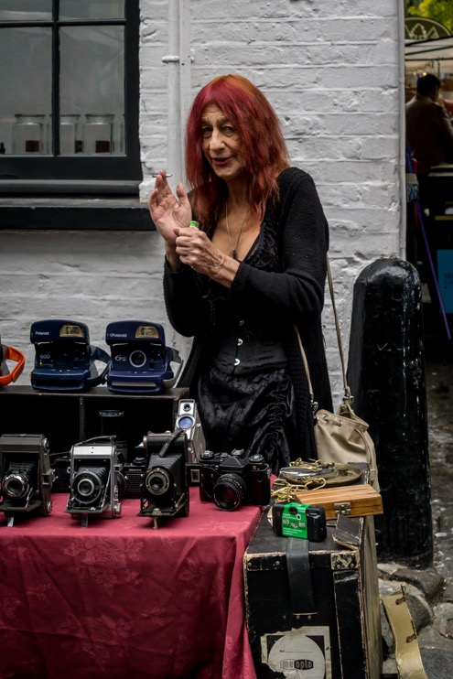
New camera supplies

Slide 37
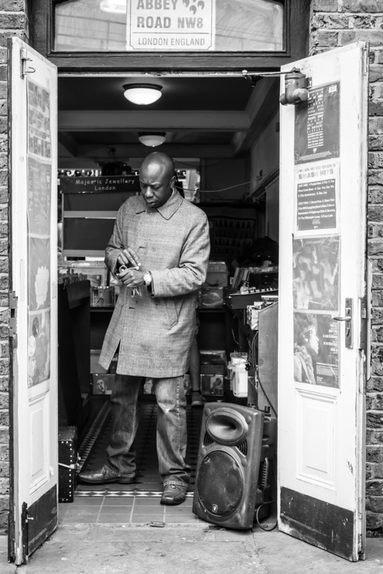
The record shop

